Slide 1

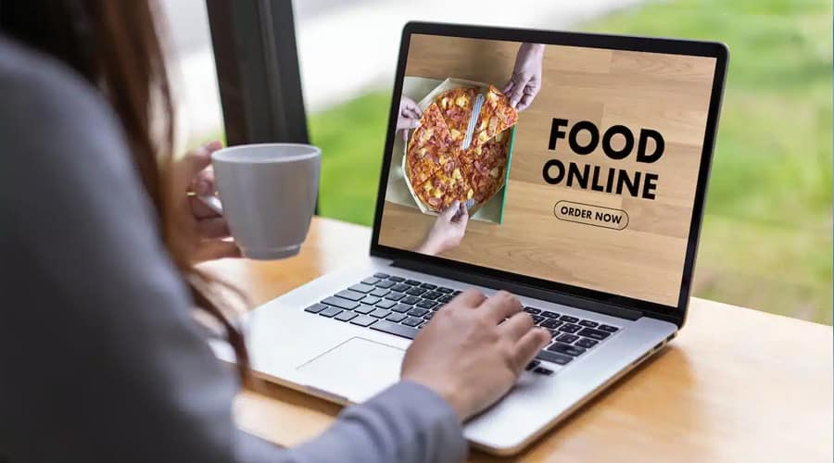
Online Food System
Under Guidance of:
Pooja Mehta
Submitted By:
1. Ankita Mune
2. Pooja Deshmukh
3. Shweta Bhoir

Slide 2
INTRODUCTION
The "Online Food System" has been developed to override the problems prevailing in the practicing manual system. This software is supported to eliminate and, in some cases, reduce the hardships faced by this existing system. Moreover, this system is designed for the particular need of the company to carry out operations in a smooth and effective manner. The application is reduced as much as possible to avoid errors while entering the data. It also provides error message while entering invalid data. No formal knowledge is needed for the user to use this system. Thus, by this all it proves it is user-friendly. Online Food System, as described above, can lead to error free, secure, reliable and fast management system. It can assist the user to concentrate on their other activities rather to concentrate on the record keeping. Thus, it will help organization in better utilization of resources.

Slide 3
PROJECT OBJECTIVE
The main objective of the Project on Online Food System is to manage the details of Food Item, Category, Customer, Order, Confirm Order. It manages all the information about Food Item, Payment, Confirm Order, Food Item. The project is totally built at administrative end and thus only the administrator is guaranteed the access. The purpose of the project is to build an application program to reduce the manual work for managing the Food Item, Category, Payment, Customer. It tracks all the details about the Customer, Order, Confirm Order.

Slide 4
TECHNOLOGIES USED
Spring Boot
MySQL
Postman
Angular

Slide 5
PROPOSED SYSTEM
System needs store information about new entry of Food Item. System needs to help the internal staff to keep information of Category and find them as per various queries. System need to maintain quantity record. System need to keep the record of Customer. System need to update and delete the record. It also needs a security system to prevent data.

Slide 6
REQUIRED SPECIFICATIONS
Hardware Configuration | Software Configuration
Operating System : Windows 10 and above | Software IDE: Eclipse, Postman, MySQL, VS Code.
Hard Disk: 500 GB | Language: JAVA, Type Script, HTML, CSS
RAM: 8 GB | Front End: Angular, Boot Strap
 | Back End: Spring Boot, MySQL.

Slide 7
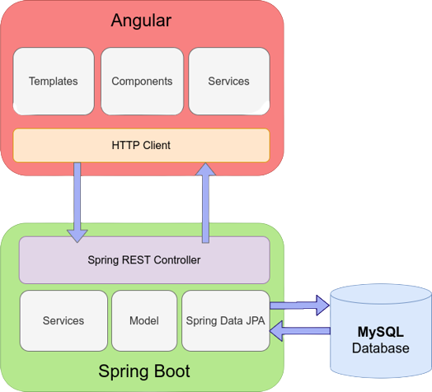
CONNECTION TO DATABASE FRONT END TO BACK END

Slide 8
MODULES
The system contains 5 Modules
ADMIN - Registration and Login.
CUSTOMER- Signup and Login.
PRODUCT LIST - Add/Edit Food items by Admin.
CART - Customer can add food from menu list
ORDER - It shows items which present in cart and order status.
PAYMENT – Customer has to pay for completion of order.

Slide 9
SPRING ANNOTATIONS
@Controller :The @Controller annotation indicates that a particular class serves the role of a controller. Spring Controller annotation is typically used in combination with annotated handler methods based on the @RequestMapping annotation.
@Autowired: The @Autowired annotation provides more fine-grained control over where and how autowiring should be accomplished.
@RequestMapping : The @RequestMapping is one of the most common annotation used in Spring Web applications. This annotation maps HTTP requests to handler methods of MVC and REST controllers.
@Entity: The @Entity annotation specifies that the class is an entity and is mapped to a database table.

Slide 10
SPRING ANNOTATIONS
@Table: The @Table annotation is used to create a table in database.
@JoinColumn: The @JoinColumn is used to specify a column for joining an entity association or element collection.
@PutMapping : The @PutMapping is used for update the records.
@PostMapping: The @PostMapping is used to create a resource Mapping.
@GetMapping: The @GetMapping is used to read all the inserted records.
@DeleteMapping : The @DeleteMapping is used to delete the records.
@PathVariable: The @Path Variable annotation is used to extract the value from the URL.
@RequestParam: The @RequestParam annotation is used to read the form data and bind it automatically to the parameter present in the provided method.

Slide 11
SPRING ANNOTATIONS
@Request Body: The @RequestBody annotation is applicable to handler methods of spring controller. spring should deserialize a request body into an object.
@OneToOne Mapping: The @OneToOne JPA annotation is used to map the source entity with the target entity, Hibernate maps the tables in your database to the Entity classes in your application.
@OneToMany Mapping: The @OneTo-Many relationship between table A and table B indicates that one row in a table A link to many rows in table B.but one row in table B links to only one row in table A.
@ManyToOne Mapping: The @Many-to-One mapping means that many instances of this entity are mapped to one instance of another entity.

Slide 12
SPRING ANNOTATIONS
@ExceptionHandler:The @ExceptionHandler is an annotation used to handle the specific exceptions and sending the custom responses to the client.
@RestController: @RestController annotation in order to simplify the creation of RESTful web services. It's a convenient annotation that combines @Controller and @ResponseBody, which eliminates the need to annotate every request handling method of the controller class with the @ResponseBody annotation..

Slide 13
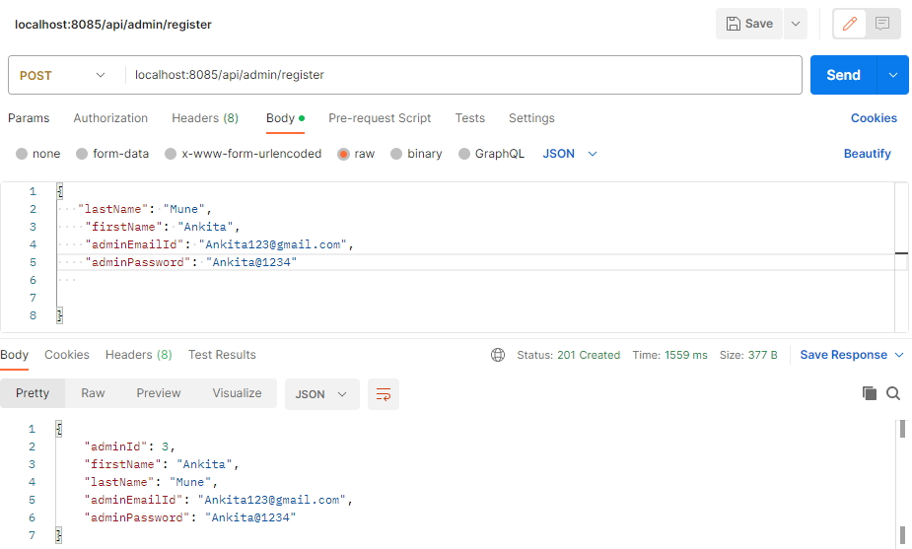
ADMIN REGISTRATION FROM POSTMAN

Slide 14
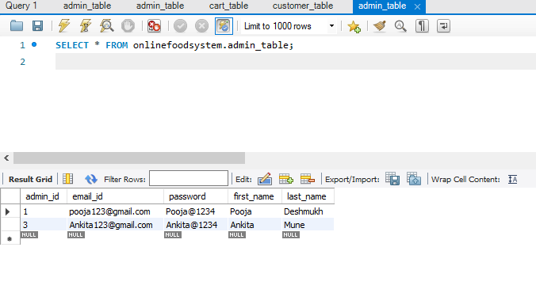
ADMIN TABLE

Slide 15
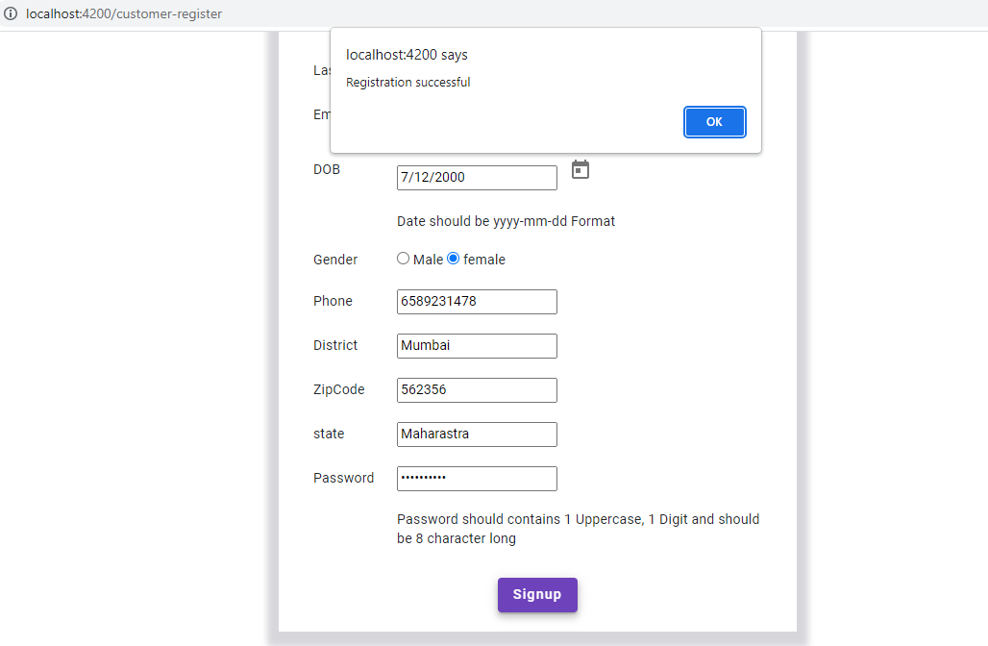
CUSTOMER REGISTRATION

Slide 16
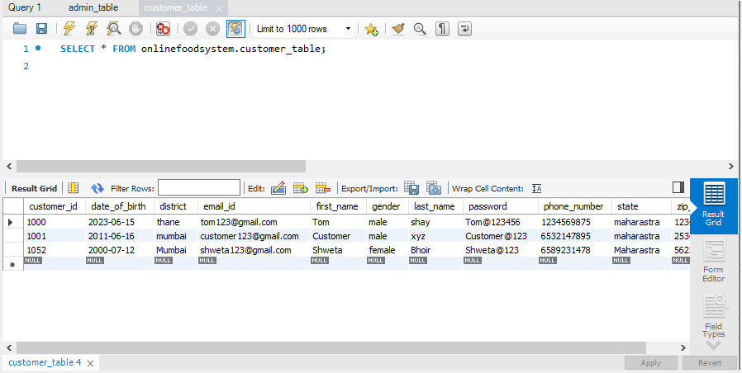
CUSTOMER TABLE

Slide 17
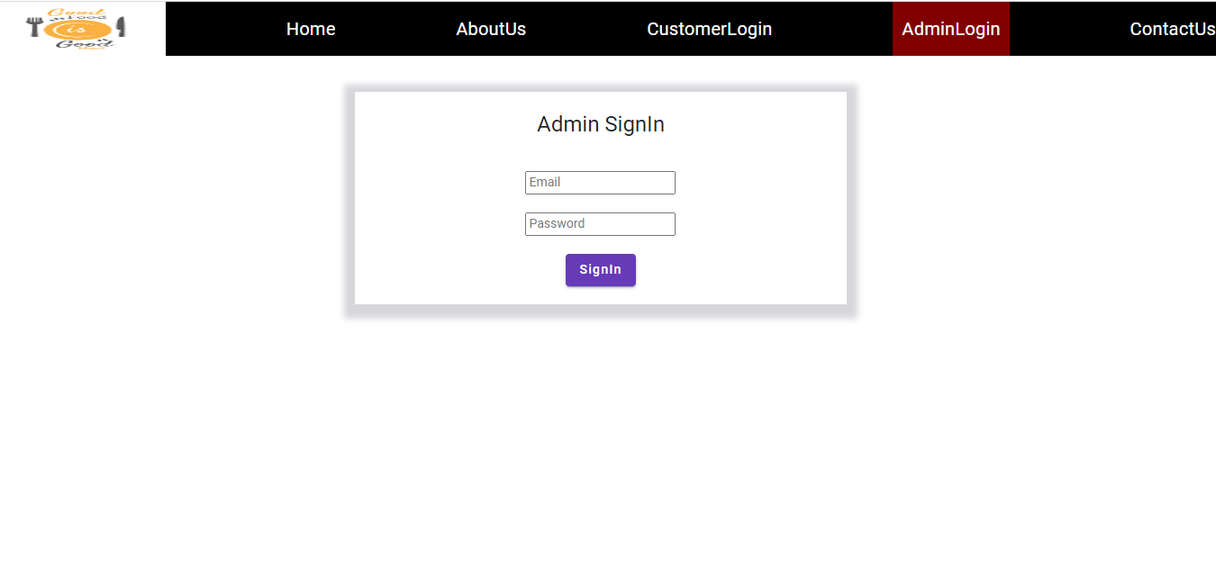
ADMIN LOGIN

Slide 18
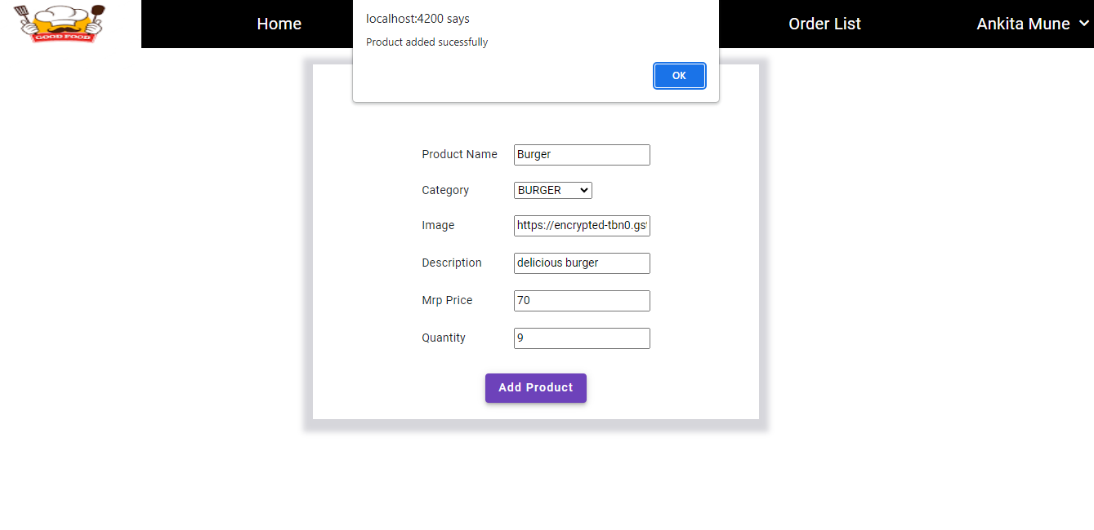
ADD PRODUCT FROM ADMIN

Slide 19
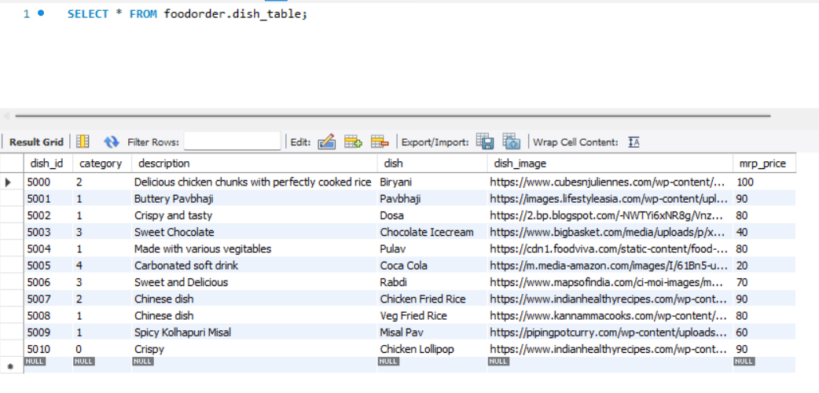
DISH TABLE

Slide 20
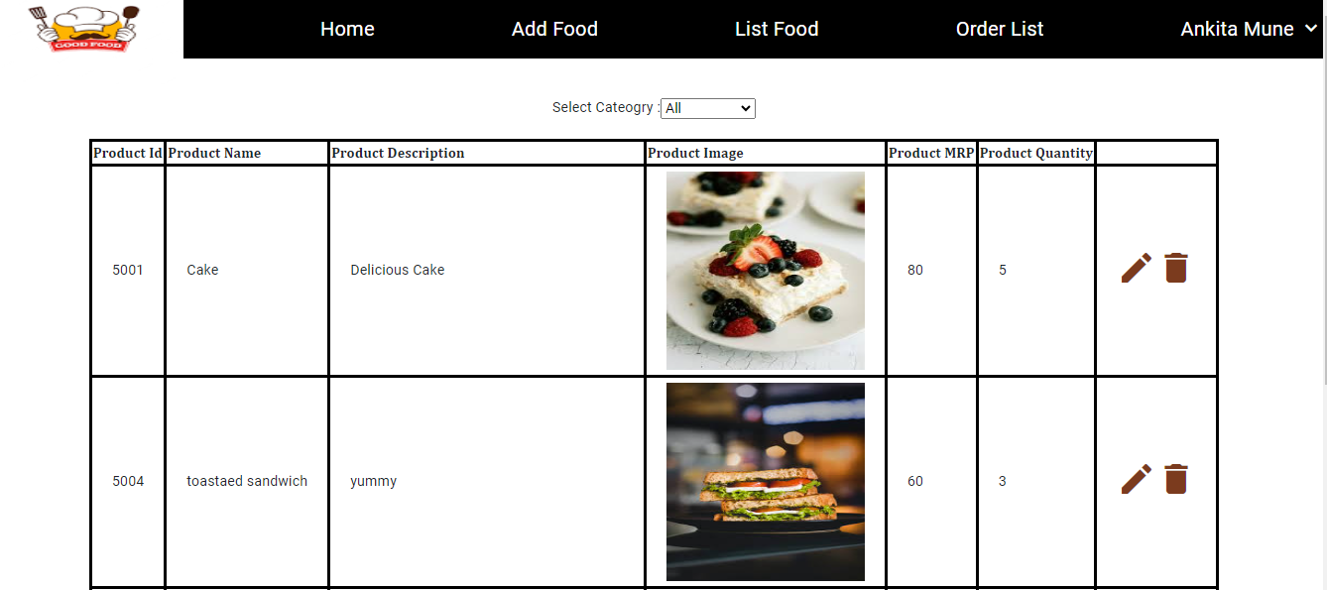
PRODUCT LIST

Slide 21
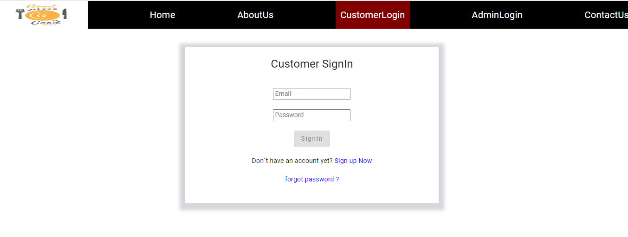
CUSTOMER LOGIN

Slide 22
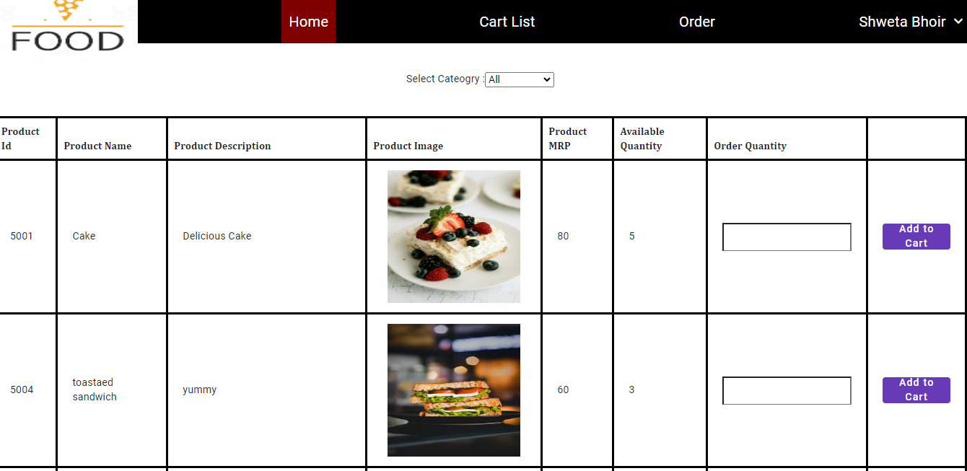
CUSTOMER HOME PAGE

Slide 23
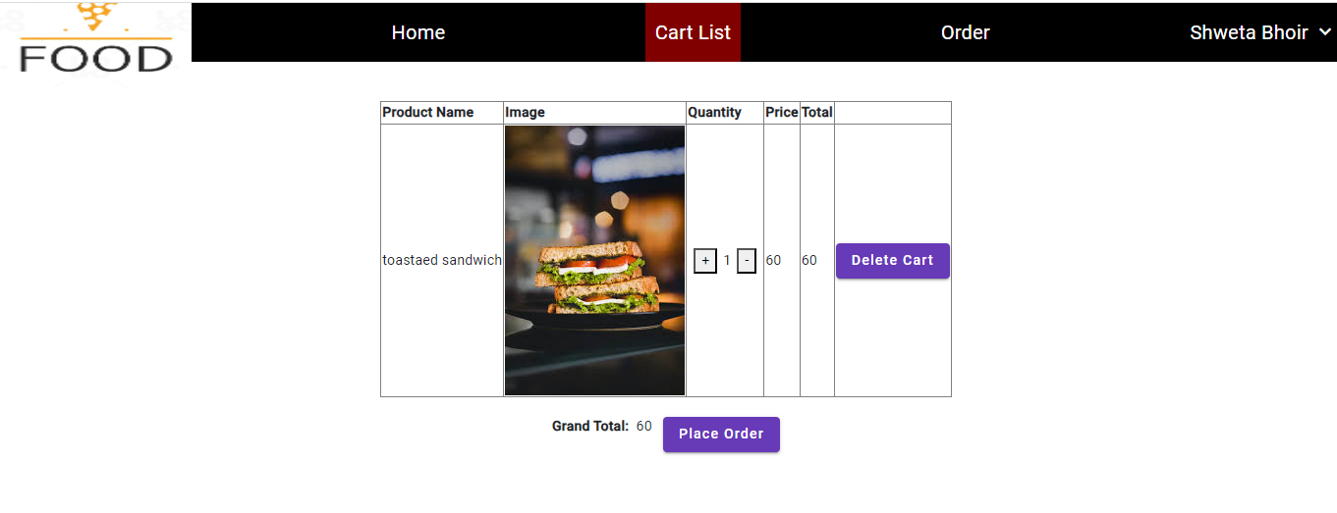
CUSTOMER CART

Slide 24
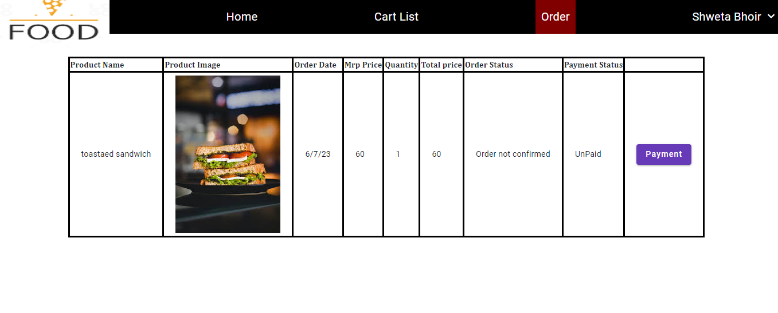
CUSTOMER ORDER

Slide 25
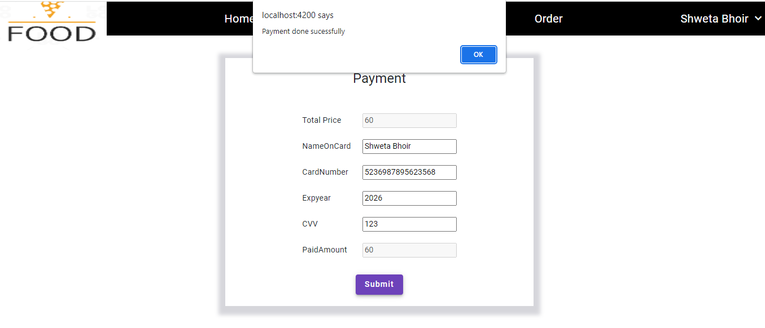
CUSTOMER PAYMENT

Slide 26
ADVANTAGES
Customer can order whenever they want..
Makes the ordering process easier.
Customer's satisfaction.
The convenience of mobile ordering
No more waiting in long queues to place an order.
Discover New Items.

Slide 27
CONCLUSION
Online Food System is done to help and solve one of the important problems of customer. Because Large number of customer can use the internet and phone. Various issues related to Mess Tiffin Service will be solved by these system .Thus, implementation of Online Food System is done to help and solve one of the important problems of customer. It helps customer in making order easily and gives information needed in making order to customer place.

Slide 28
THANK YOU

